Slide 1
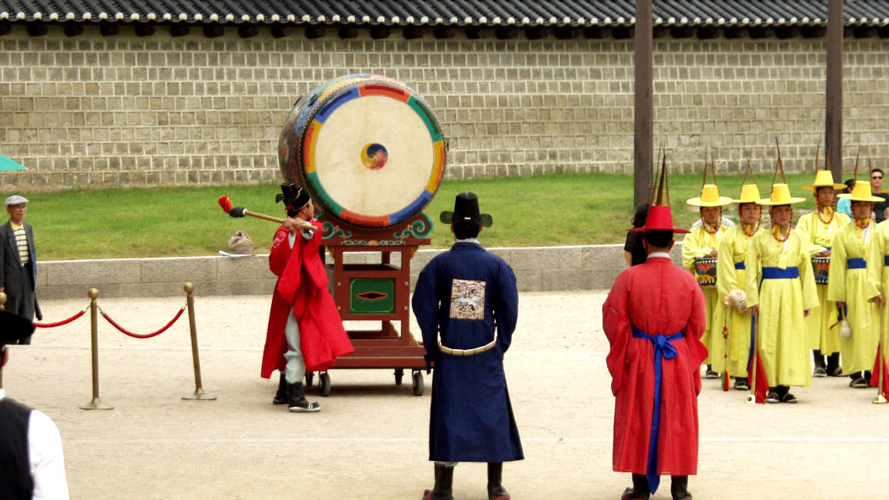
Class 6:
Proofs of Work
Cryptocurrency Café
UVa cs4501 Spring 2015
David Evans

Slide 2
Plan for Today
Project 1
Distributed Consensus
Proof-of-Work
Blockchain

Slide 3
Project 1
Graded on 100,000 satoshi scale
Full credit:
Successfully generated vanity address and transferred coin to it
Contributed something of value to discussions
If you did this, should have received a transfer to your vanity address of 100,000 satoshis
If not, can make up for this by posting something of value by Thursday.

Slide 4
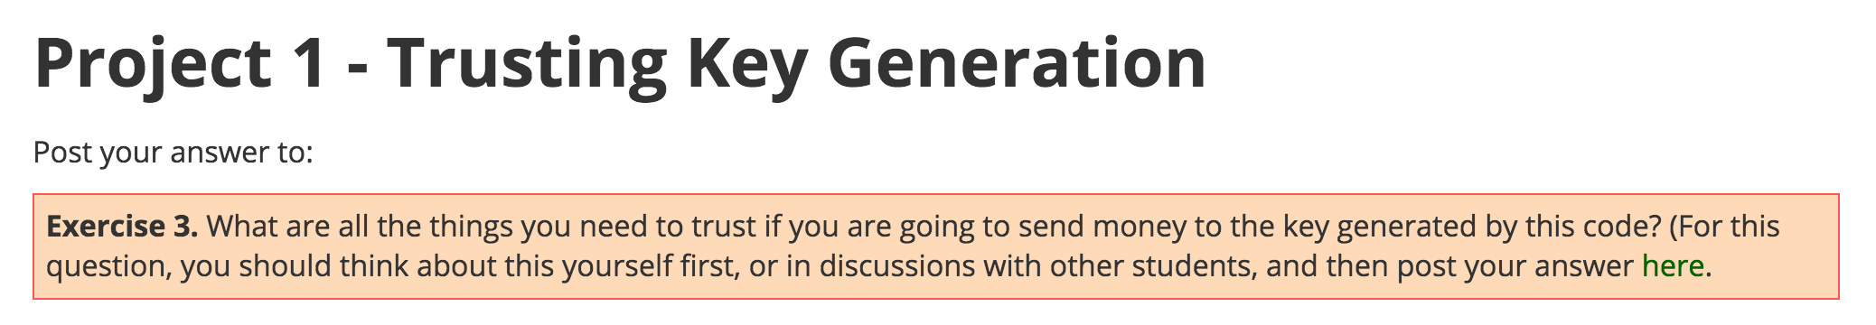
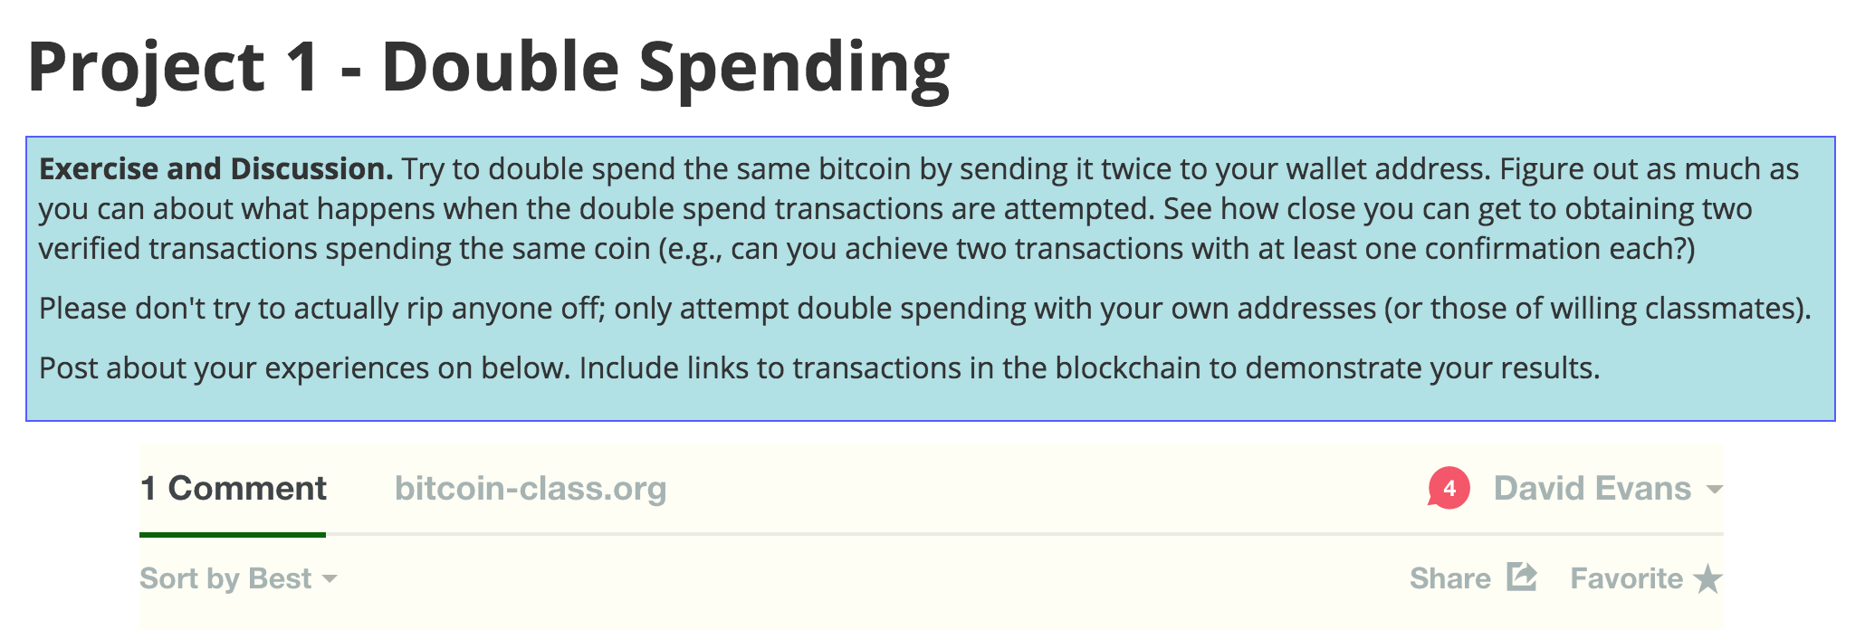
Opportunities for Value
You should have better ideas of things to try after today…

Slide 5

Where does trust come from?

Slide 6
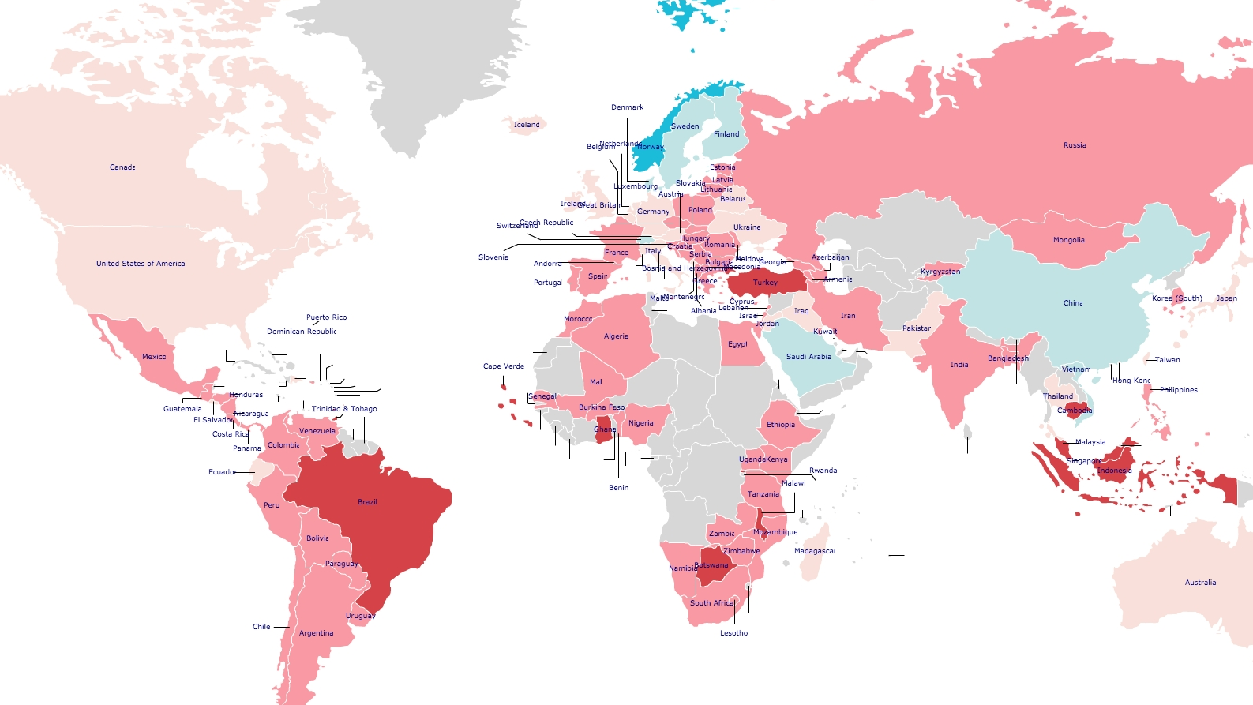

http://www.jdsurvey.net/jds/jdsurveyMaps.jsp

Slide 7
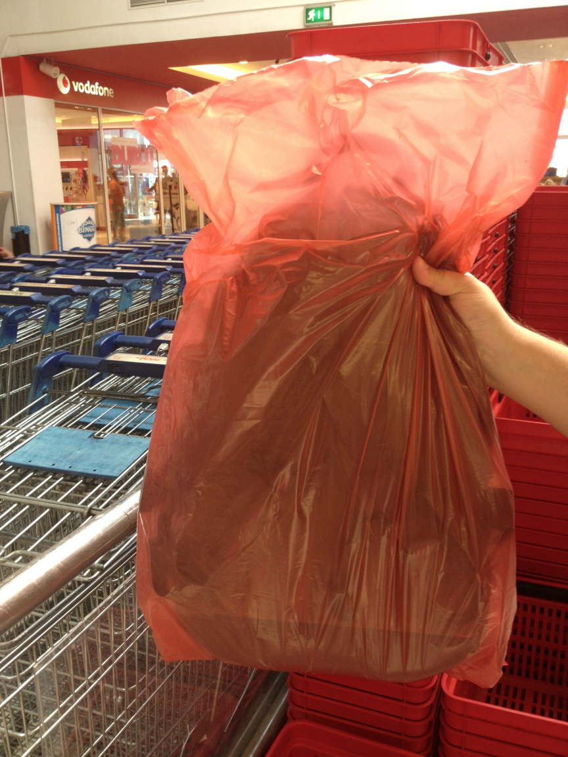
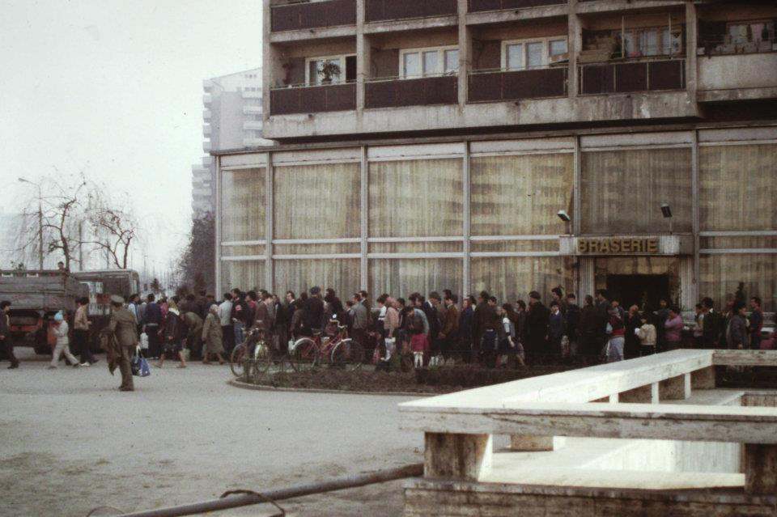
Queuing for cooking oil (Bucharest, 1986)
Scott Edelman
Image credit: https://howveryromanian.wordpress.com/2013/09/15/bag-wrapping/

Slide 8
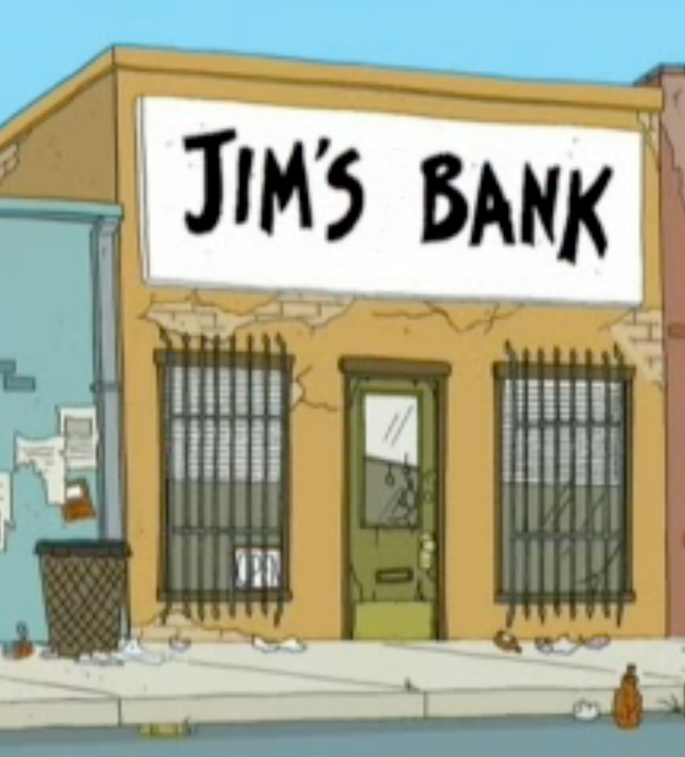
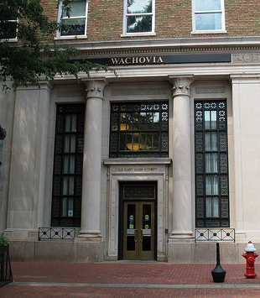

Slide 9
Sources of Trust
Yourself (super trustworthy!)
Mathematics and Science
Trustworthy because of logic, verified experiments
Organizations and People
Trustworthy because of what they have to lose (reputation)
Trustworthy because of trusted oversight (law, police)
Trustworthy because incentives are aligned
Trustworthy because of processes they follow

Slide 10
Project 1 Comments
“A good deal of the cryptography is new to me so maybe a little more "big picture" how this all connects would be helpful for people feeling the same way.”
“Some details about cryptography in class are difficult to grasp without any prior knowledge on the subject.”

Slide 11
Project 1 Comments
“It also seems like there are questions listed on the class notes that aren’t necessarily covered/touched upon in class meetings. In order to better understand the material, I feel like it would be good to either touch upon these in class or via an online discussion forum.”

Slide 12
Project 1 Comments
“I think it would be interesting to talk about the start up scene around bitcoin in more depth.”
“I would like to see more current issues about the market being discussed in class at some point soon - maybe through presenting some new bitcoin news at the beginning of every class.”

Slide 13
Project 1 Comments
“Homework directions were REALLY vague.”
“I feel that in my past CS classes everything is already set up nice and tidy on a VM for you and there's little to figure out on your own.
“I think that the assignments need to be designed much more clearly. Specifically, we need much clearer descriptions on what software, downloads, and packages we will need. This was absolutely the hardest part of project1: getting git set up, and recognizing that you needed to no only install go but also the btcsuite stuff. After this was accomplished, the project was a more than reasonable exploration into vanity addresses and bitcoin transactions.”

Slide 14
This generation of students got into “UVa” by doing exactly and precisely what teacher wants. If teacher is vague about what he wants, they work a lot harder to figure out what they want and whether or not it is good. The vaguer the directions, the more likely the opportunity for serendipity to happen. It drives them nuts!
Harvard Professor John Stilgoe
(on "60 Minutes", 4 January 2004)

Slide 15
Redemption on Project 1
If you didn’t get full credit for Project 1 because of failure to post something interesting, you can (and should!) redeem yourself and earn full credit by posting an interesting comment by Thursday:
Discussion questions from Project 1
Notes from classes
General forum

Slide 16
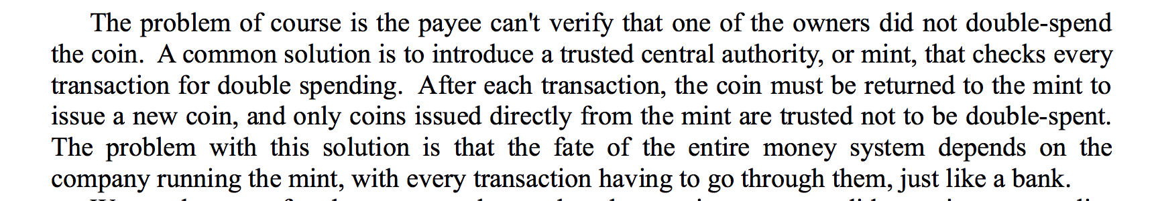
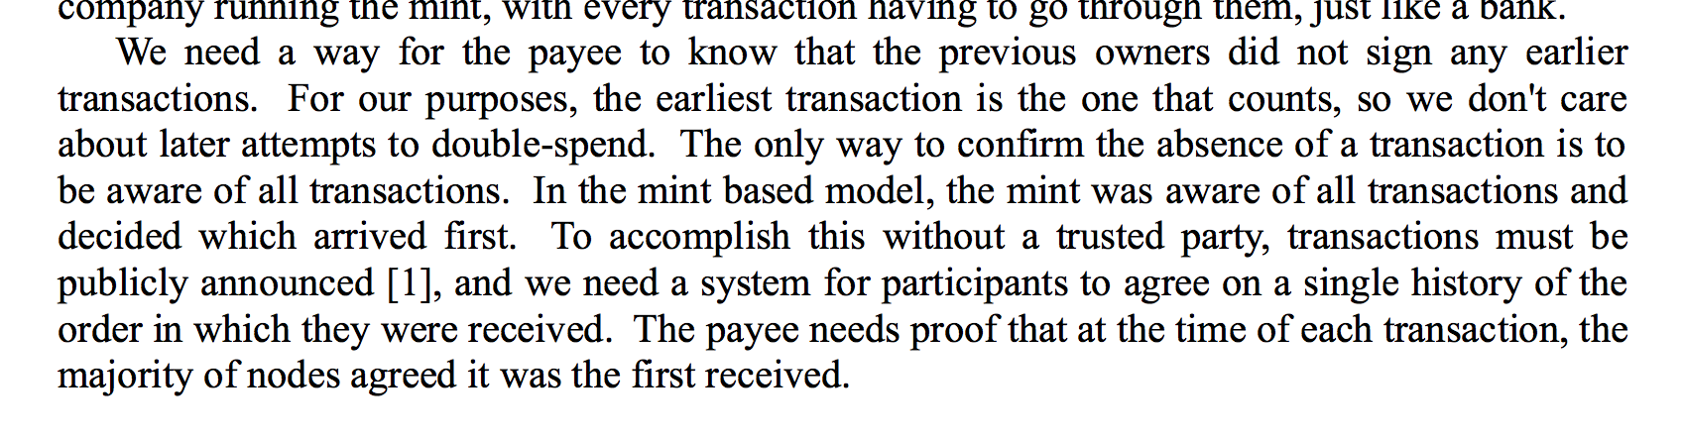
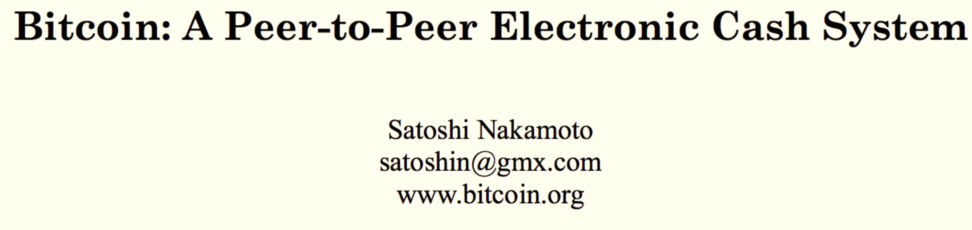
Bitcoin’s solution: a public ledger

Slide 17


Public Ledger
Node A
Node B
Node C
Bob wants to verify:
Alice hasn’t already transferred X
The coin will be valuable for Bob
M = transfer X to Bob
E_{KRA}[H(M)]

Slide 18
Public Ledger: Distributed Trust (?)
Node A
Node B
Node C
t_{b}
t_{b}
t_{b}
Bob wants to verify:
Alice hasn’t already transferred X
The coin will be valuable for Bob
M = transfer X to Bob
E_{KRA}[H(M)]
t_{b}

Slide 19
Transactions
1 | t_{b} (X->Bob)
Transactions
1 | t_{b} (X->Bob)
t
Node A
Node B
Node C
ok!
t_{b}
t_{b}
t_{b}
ok!
Bob wants to verify:
Alice hasn’t already transferred X
The coin will be valuable for Bob
M = transfer X to Bob
E_{KRA}[H(M)]
t_{b}

Slide 20
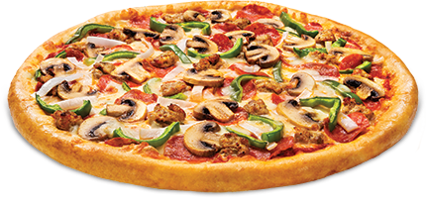
Transactions
1 | t_{b} (X->Bob)
Transactions
1 | t_{b} (X->Bob)
t
Node A
Node B
Node C
ok!
t_{b}
t_{b}
t_{b}
ok!
t_{b}
Bob wants to verify:
Alice hasn’t already transferred X
The coin will be valuable for Bob

Slide 21
Transactions
1 | t_{b} (X->Bob)
Transactions
1 | t_{c} (X->Cathy)
Transactions
1 | t_{b} (X->Bob)
t
Node A
Node B
Node C
BAD!
t_{c}
t_{c}
t_{c}
M = transfer X to Cathy
E_{KRA}[H(M)]
t_{c}

Slide 22
Scaling the Network
Node D
Node E
Node F
Node G
Node A
Node B
Node C
t_{b}
t_{a}
t_{b}

Slide 23
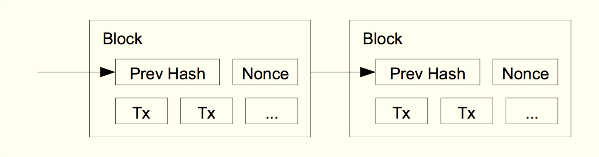
Blockchain
Public ledger without fixed set of nodes – decentralized, distributed trust
Requires coalition with majority of computing power to collude to cheat

Slide 24
Blockchain
B0
H(B0)
Nonce
H(B1)
Nonce
H(B2)
Nonce
Transactions
Transactions
Transactions

Slide 25
Inconsistent Blockchains
Node D
Node E
Node F
Node G
Node A
Node B
Node C
How do we know which blockchain is “correct”?

Slide 26
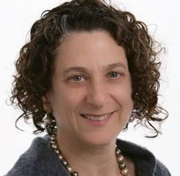
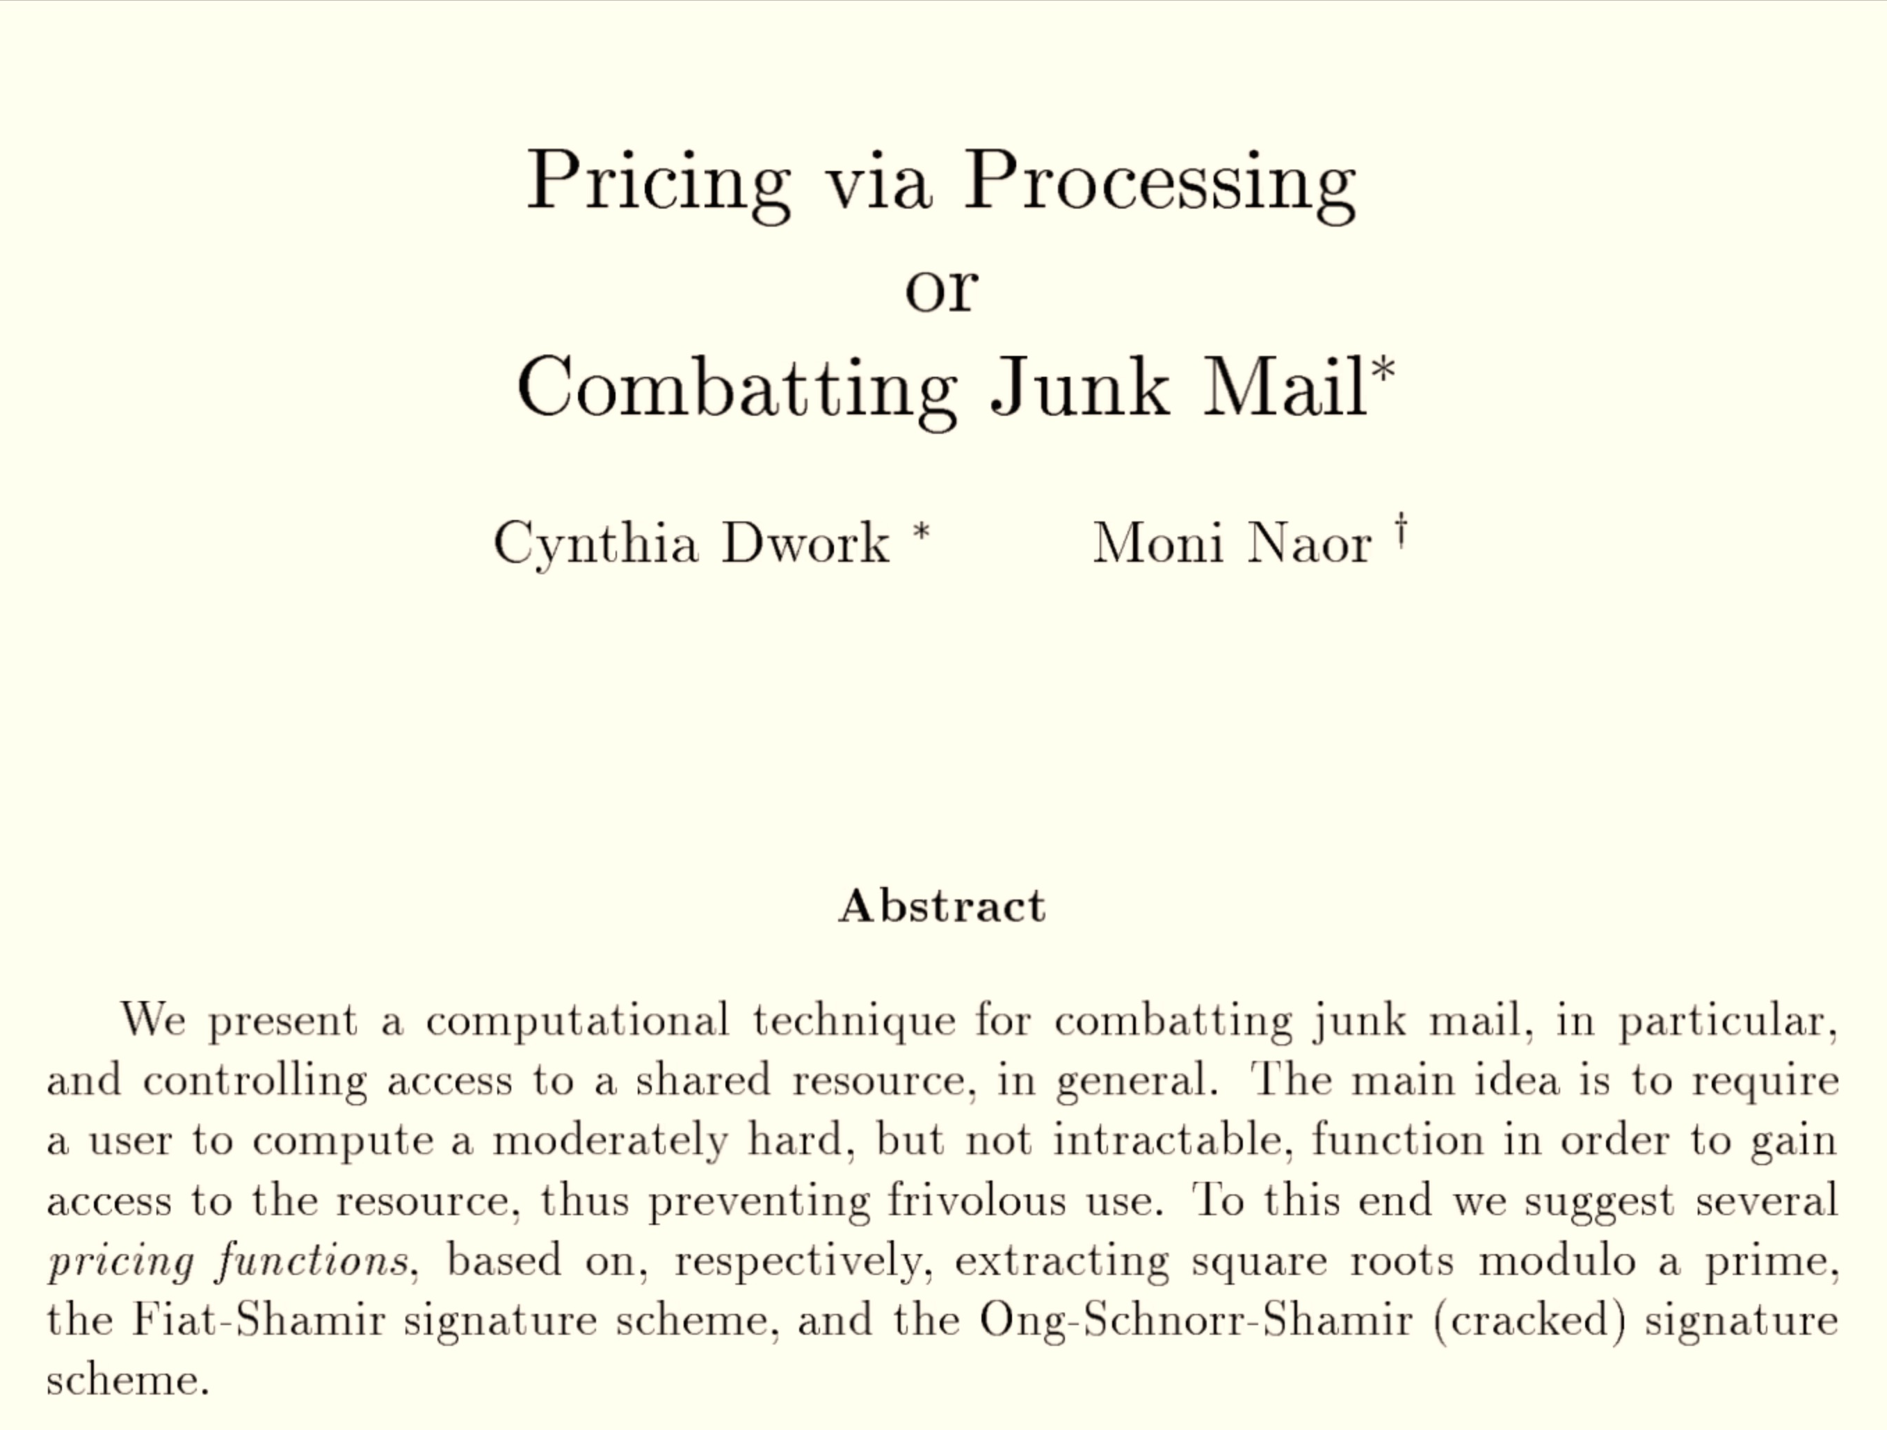
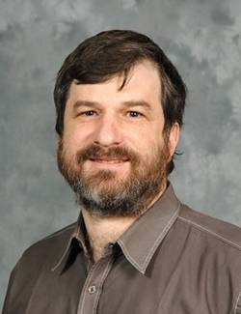
CRYPTO 1992
Cynthia Dwork
(now at MSR)
Moni Naor
(Weizmann Institute)

Slide 27
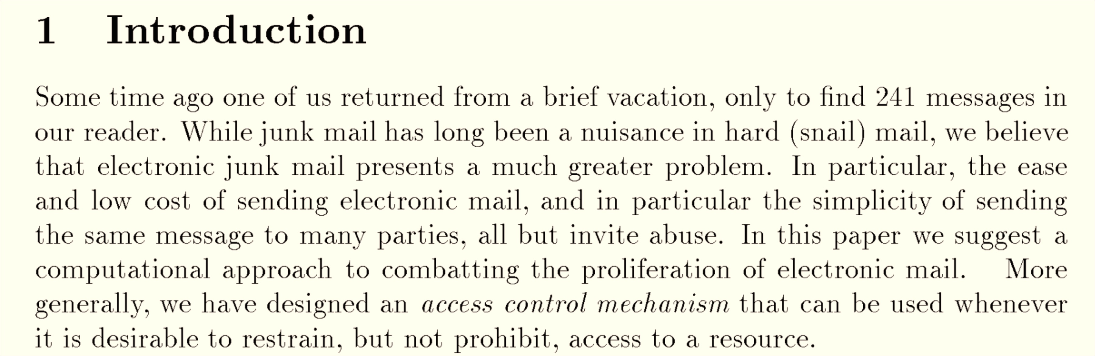

Slide 28
Idea: Proof-of-Work
Pricing Function: (f)
- moderately easy to compute
- cannot be amortized
computing f(m₁),…, f(m_{l}) costs l times as
much as computing f(m_{i}).
- easily verified: given x, y easy to check y = f(x)

Slide 29
Proposed Pricing Function
Extracting Square Roots
index: p
find x, y such that y² = x mod p
Dwork and Naor proposed two other pricing functions, designed to have “shortcuts” (backdoors) to allow administrators to compute them efficiently.

Slide 30
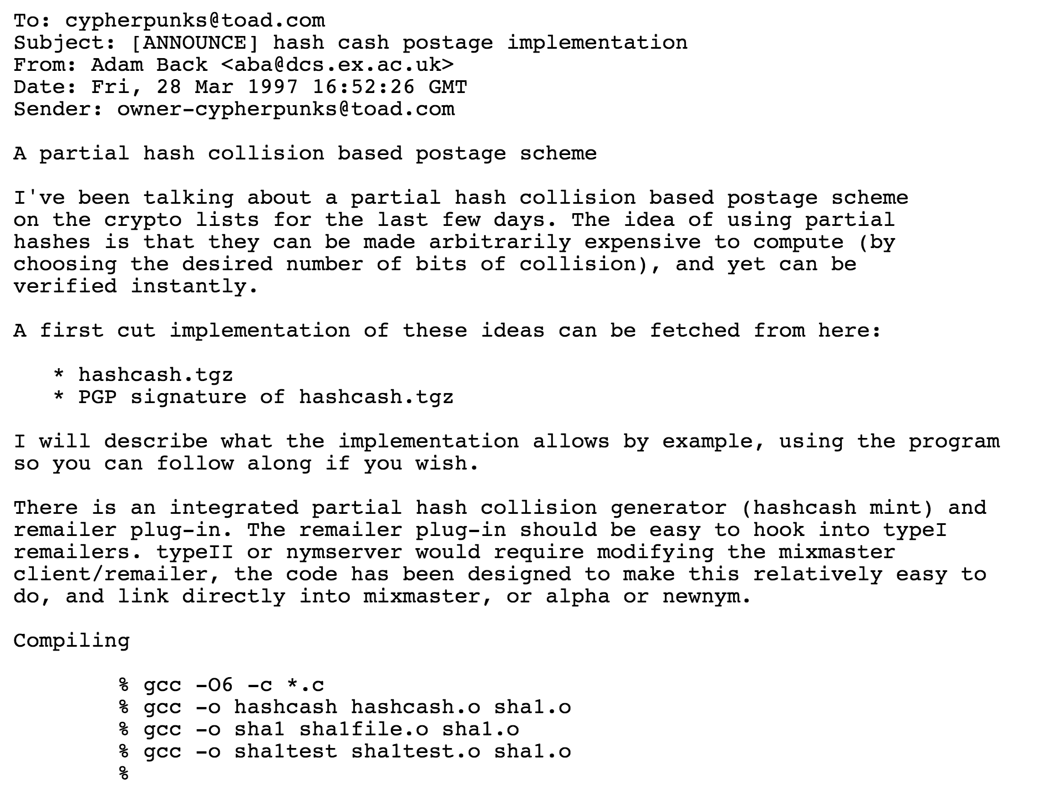
Hashcash Adam Back 1997

Slide 31
Interactive Hashcash
Everyone agrees on one-way function f
mail sender
mail recipient’s server
Hello
r ⬅ random nonce
Challenge: r

Slide 32
Interactive Hashcash
Everyone agrees on one-way function f
mail sender
mail recipient’s server
Hello
r ⬅ random nonce
Challenge: r
search for x such that
f(x) = r
(x, Mail)

Slide 33
Interactive Hashcash
Everyone agrees on one-way function f
mail sender
mail recipient’s server
Hello
r ⬅ random nonce
Challenge: r
search for x such that
f(x) = r
(x, Mail)
Verify f(x) = r
Can we make this non-interactive?

Slide 34
Non-Interactive Hashcash
Everyone agrees on one-way function f
mail sender
mail recipient’s server
(Mail, x)
r ⬅ random nonce
Challenge: r
search for x such that
f(x) = r
(x, Mail)
Verify f(x) = r
How well would this work if f is SHA-256?

Slide 35
Pre-image Attack on SHA-256
Requires approximately 2²⁵⁵ attempts
Bitcoin Network total hashrate: 316,012,834 GH/s

Slide 36
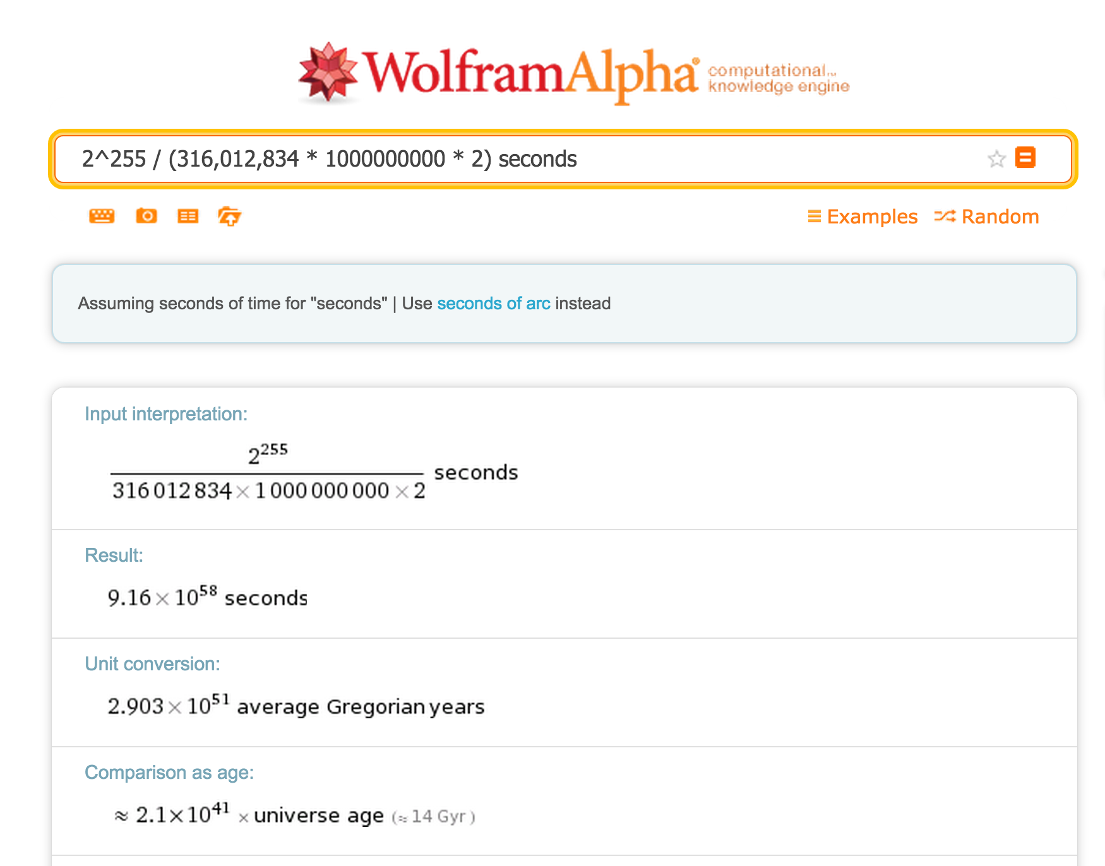


Slide 37
Non-Interactive Hashcash
Everyone agrees on one-way function f
mail sender
mail recipient’s server
(Mail, x)
r ⬅ random nonce
Challenge: r
search for x such that
f(x) = r
(x, Mail)
Verify f(x) = r
Making an easier f

Slide 38
Variable-Difficulty f
Challenge: r, Difficulty: d
Find an x such that:

Slide 39
Variable-Difficulty f
Challenge: r, Difficulty: d
Find an x such that:
SHA-256(r + x) < T/d
T is some set “target”.
If the difficulty doubles, how much more work is expected?

Slide 40
Bitcoin’s Proof-of-Work
Find an x such that:
SHA-256(SHA-256(r + x)) < T/d
Why use double SHA-256?

Slide 41
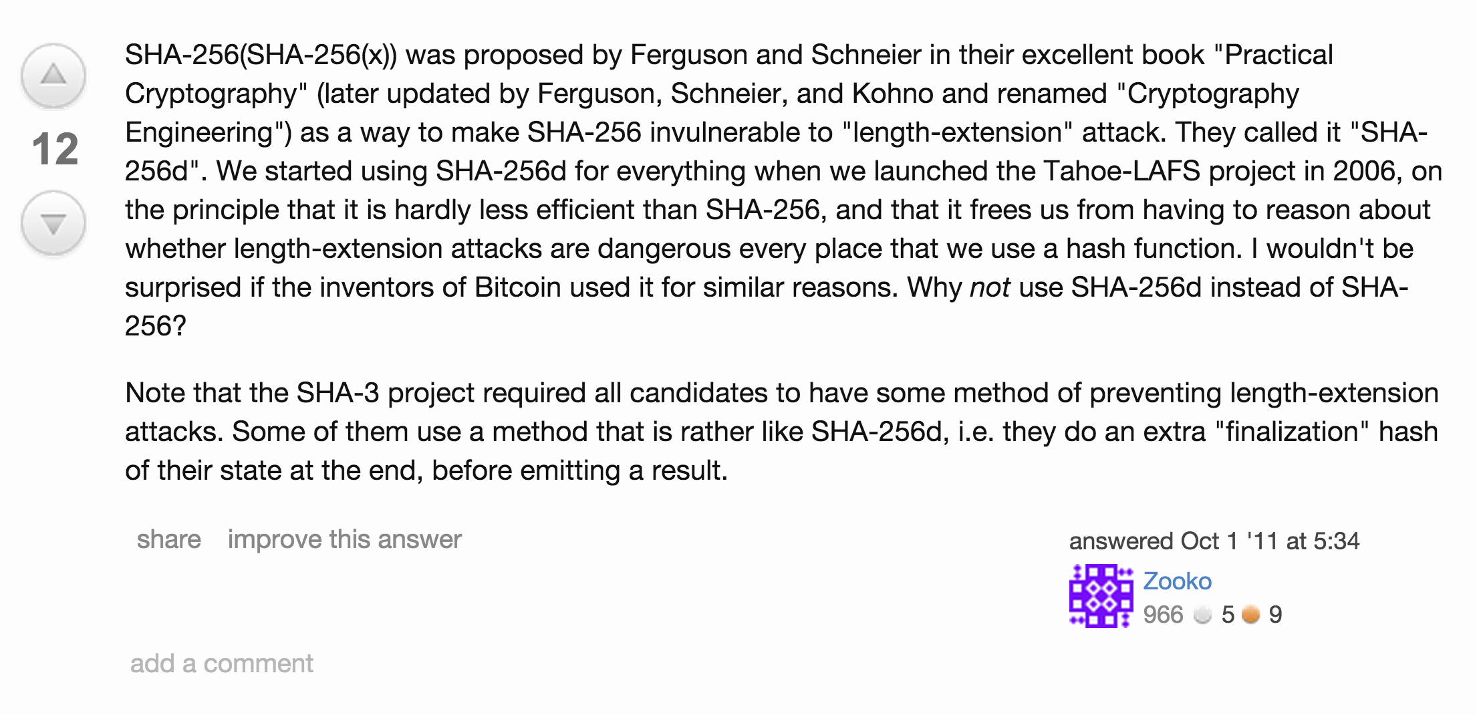
http://crypto.stackexchange.com/questions/779/hashing-or-encrypting-twice-to-increase-security

Slide 42
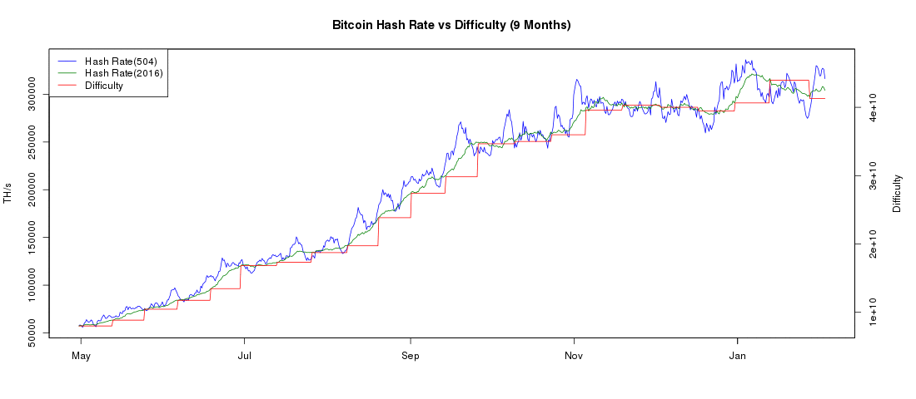
Bitcoin’s Difficulty
Difficulty adjusts (every 2016 blocks) to keep block-finding time around 10 minutes
https://bitcoinwisdom.com/bitcoin/difficulty

Slide 43
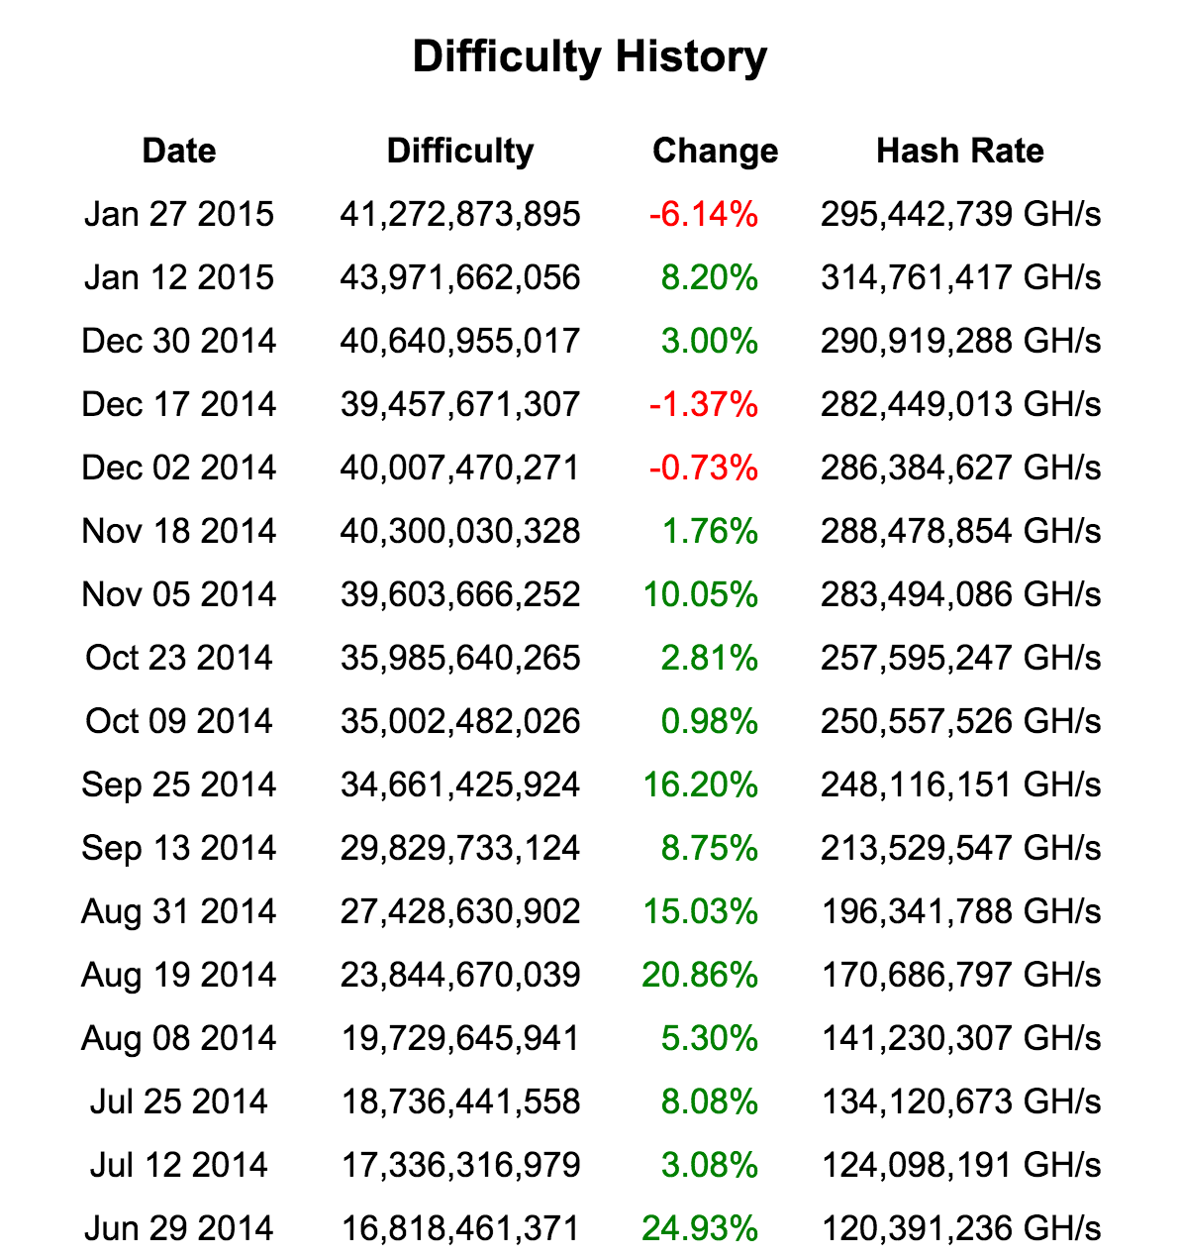
https://bitcoinwisdom.com/bitcoin/difficulty

Slide 44
Finding the Next Block
B0
H(B0)
Nonce
H(B1)
Nonce
H(B2)
Nonce
Transactions
Transactions
Transactions
Find a nonce x such that:
SHA-256(SHA-256(r + x)) < T/d

Slide 45
Finding the Next Block
B0
H(B0)
Nonce
H(B1)
Nonce
H(B2)
Nonce
Transactions
Transactions
Transactions
Find a nonce x such that:
SHA-256(SHA-256(r + x)) < T/d
r = header + transactions (including mining fee)
header = H(previous block)

Slide 46
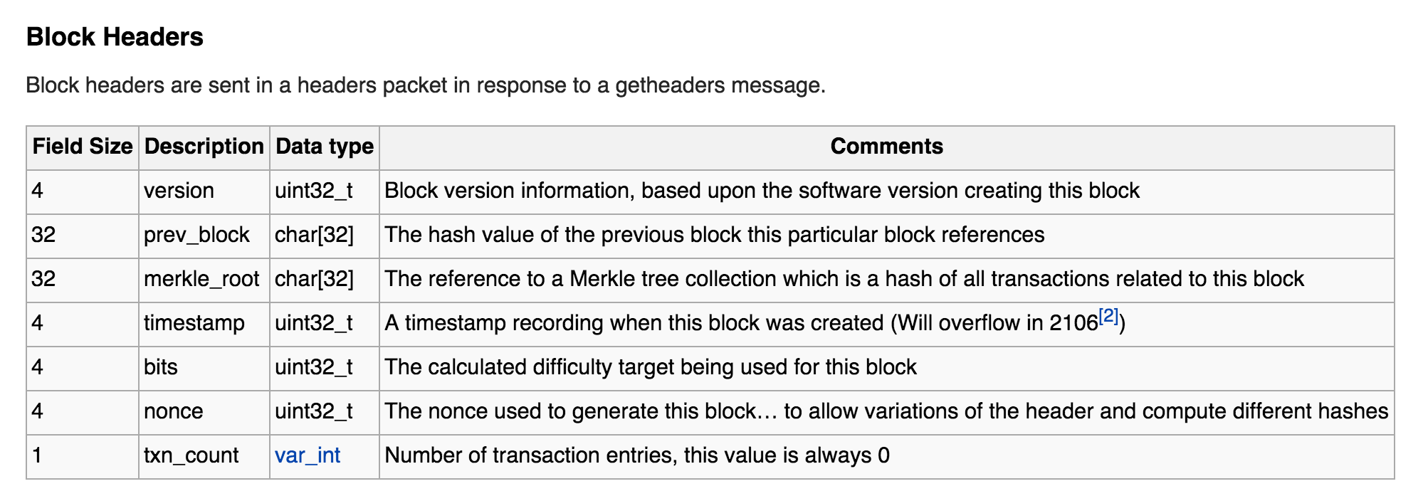
Actual Bitcoin Block
https://en.bitcoin.it/wiki/Protocol_documentation#Block_Headers

Slide 47
Inconsistent Blockchains
Node D
Node E
Node F
Node G
Node A
Node B
Node C
The longest blockchain is the “right” one.

Slide 48
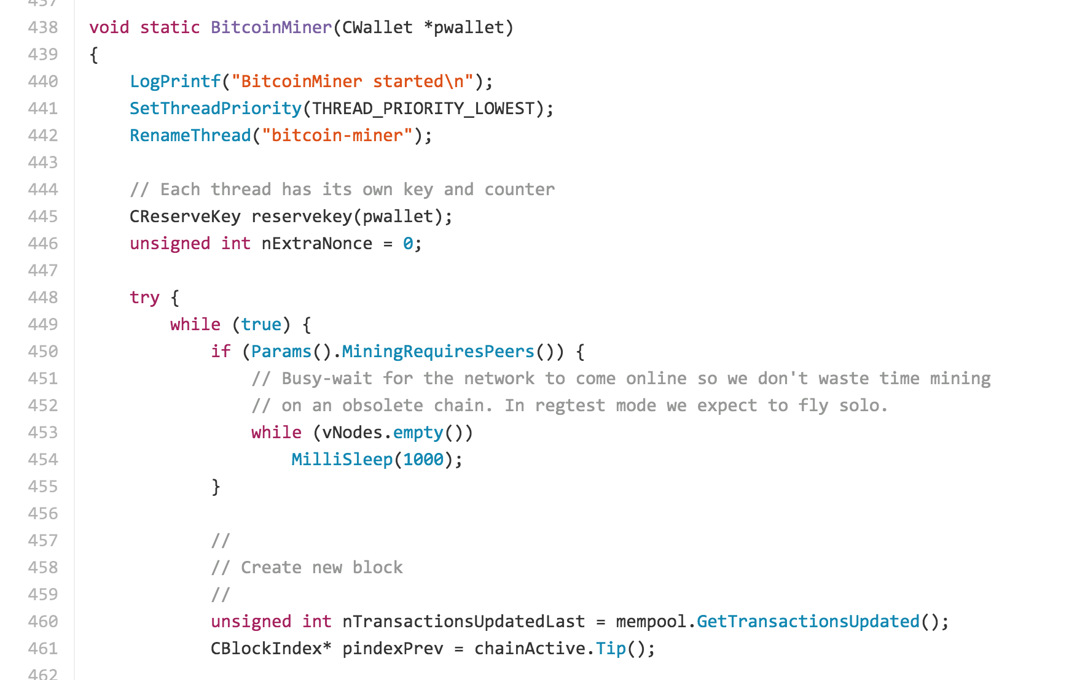
from bitcoin core:
bitcoin/miner.cpp
https://github.com/bitcoin/bitcoin/blob/40e96a30160ddc2cb39bc9b86ec103ac892e09ab/src/miner.cpp#L486

Slide 49
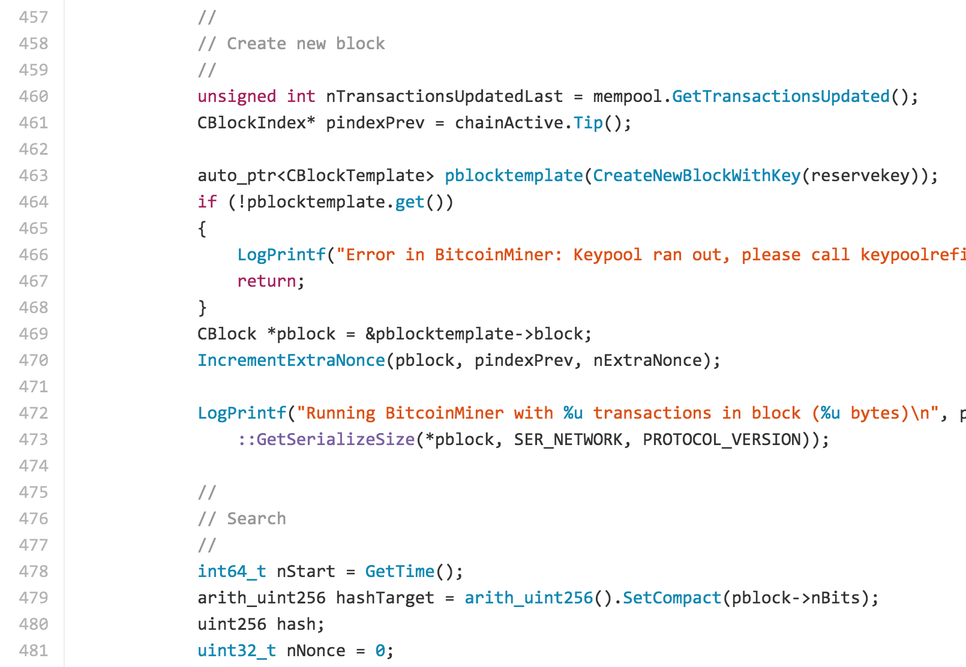
from bitcoin core:
bitcoin/miner.cpp

Slide 50
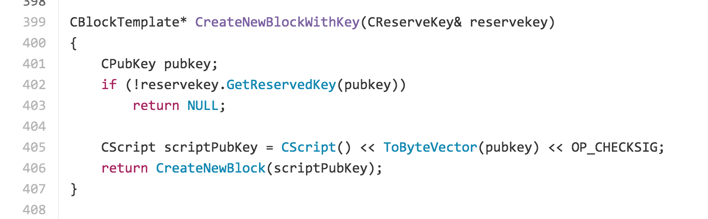
from bitcoin core:
bitcoin/miner.cpp
CreateNewBlock

Slide 51
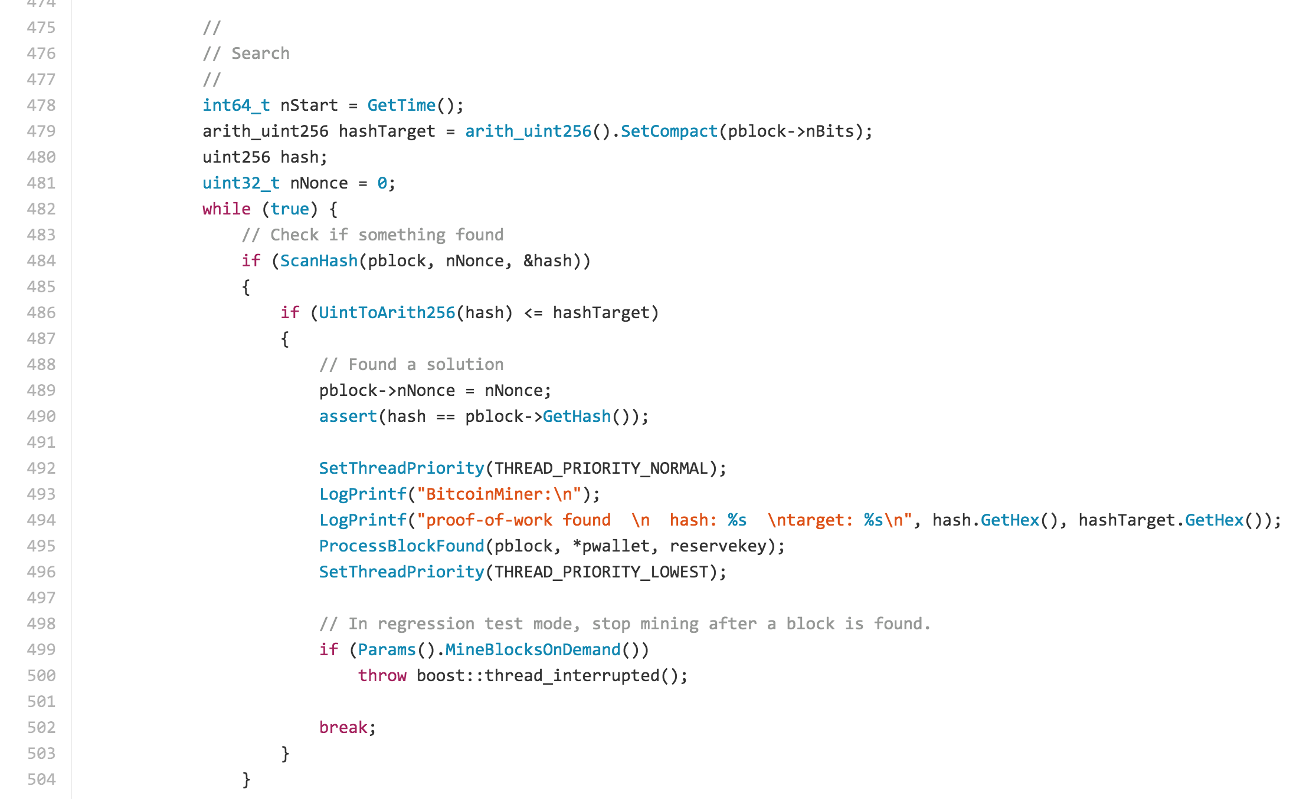

Slide 52
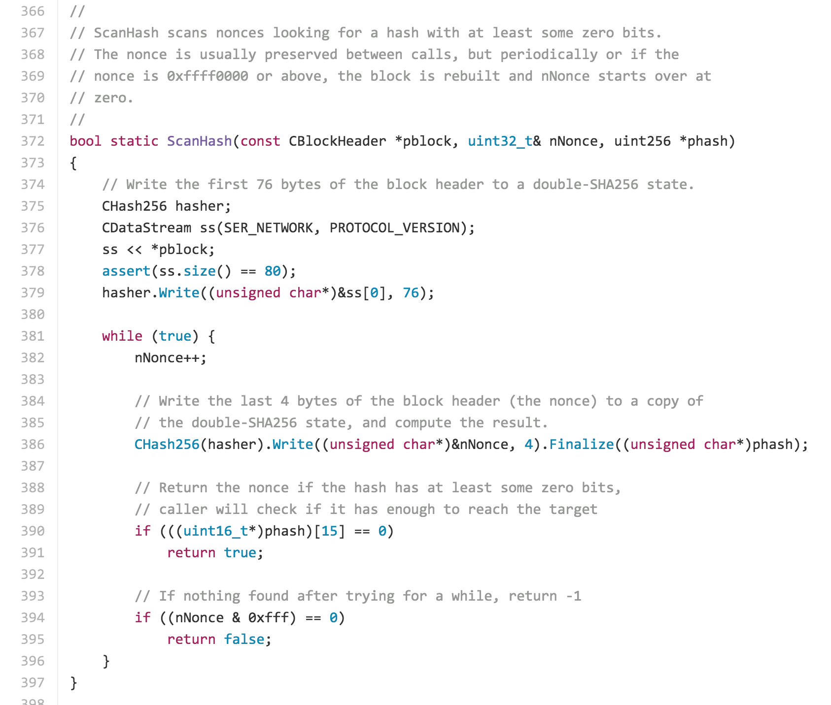

Slide 54
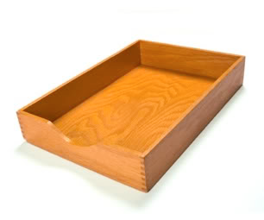
What happened to proof-of-work for sending email?

Slide 55
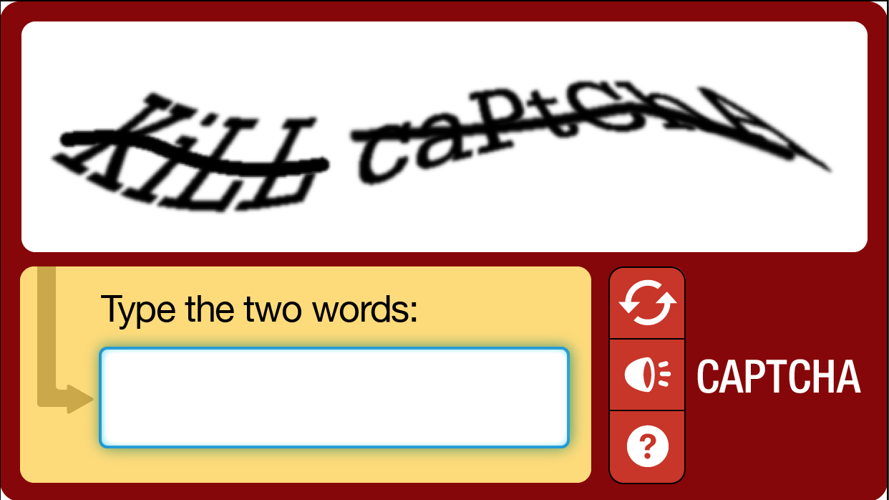
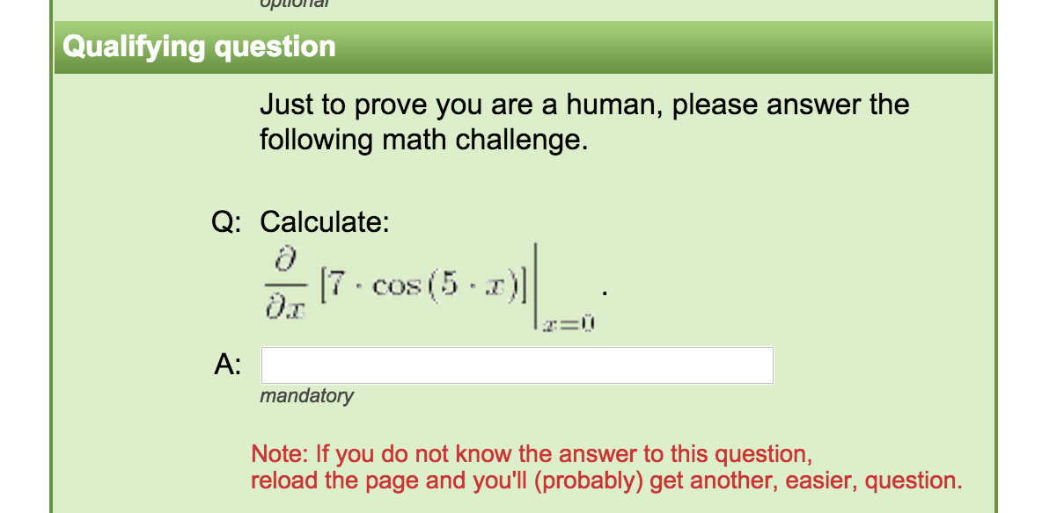
Instead of making computers do inane, repetitive work to prevent mass automation, we make humans do inane, soul-killing work!

Slide 56
Charge
Wednesday: Merkle Trees (recording transactions)
Project 2 will be posted Wednesday, due Feb 22
If you did not receive a grade for Project 1 yet, you have until Thursday to contribute a worthwhile comment to justify full credit for Project 1.

